Slide 1


Fast and Scalable Backend Systems with FastAPI
Day 1: Session 2

Slide 2

Table of Contents
1
REST Architecture
2
CRUD Operations
3
HTTP Methods
4
Project

Slide 3





REST
REST stands for Representational State Transfer, an architectural style introduced to guide the design of web systems. It organizes interactions around resources each identified by a unique URI. The client communicates with the server using standardized HTTP methods and receives data in formats like JSON or XML
Why Use REST?
Key Principles
RESTful web services are popular because they’re easy to use, language-agnostic, scalable, and integrate well with mobile and cloud platforms. REST’s statelessness and reliance on HTTP make APIs straightforward to develop, test, and maintain
Statelessness
Uniform Interface
Resource-Based
Client-Server Separation

Slide 4



C
R
U
D
CREATE
READ
UPDATE
DELETE
Add new data
Retrieve existing data.
Modify existing data
Remove data.

Slide 5

Example Analogy: Online Library
Imagine you’re building an online library. Each book in your catalog is a resource (like /books/1). How would you let users interact with these books? They might want to view a book’s details, add a new one, update an existing one, or remove a book from the catalog.
These actions are exactly what REST methods like GET, POST, PUT, and DELETE are designed to handle

Slide 6
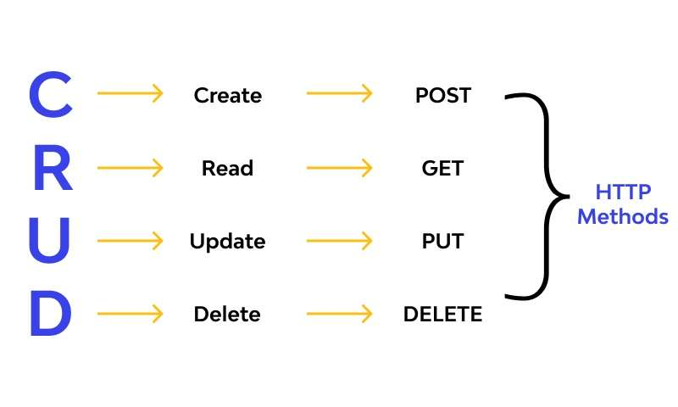
HTTP methods are standardized commands used by web clients and servers to communicate on the internet, particularly in RESTful APIs

Slide 7
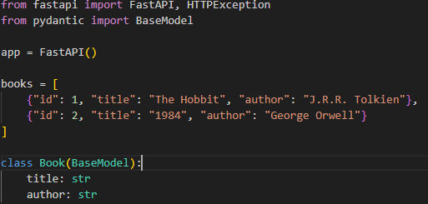
Setup

Slide 8

GET

Slide 9
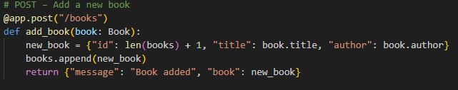
POST

Slide 10
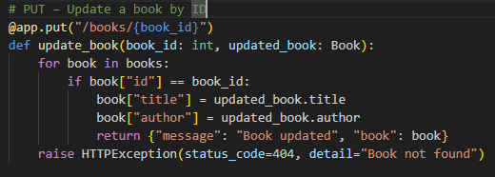
PUT

Slide 11
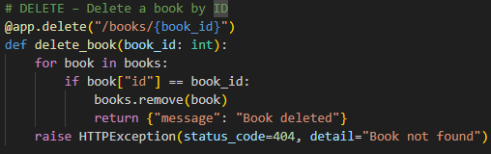
DELETE

Slide 12

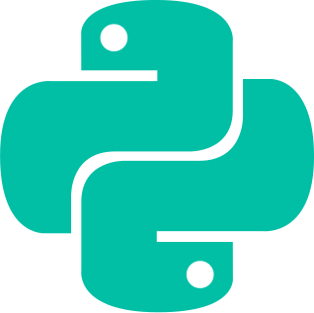
Project: Quiz Application
Requirements
Libraries
Python
fastapi – Main web framework.
pydantic – Data validation and serialization (BaseModel).
sqlalchemy – ORM for database interaction.
jinja2 – Templating engine for HTML pages.
python-multipart – Required for form data (Form) and file uploads.
pip install fastapi uvicorn pydantic sqlalchemy jinja2 python-multipart
Version 3.9

Slide 13
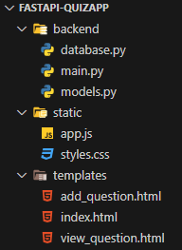
Project: Quiz Application
Folder Structure

